Slide 1
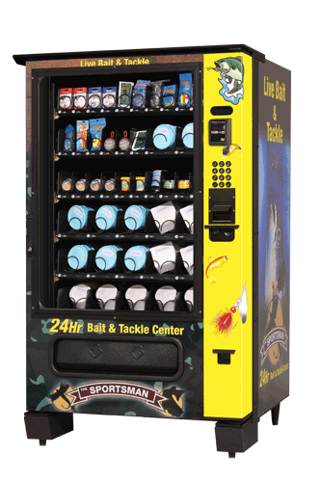
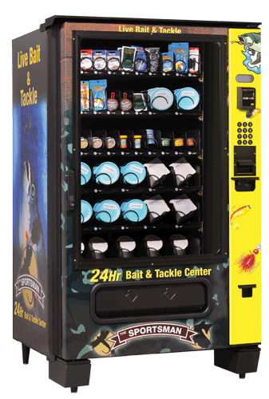

Setting up your Sportsman 24 Hour Bait Shop
Understanding your new vendor
QUICK START GUIDE

Slide 2
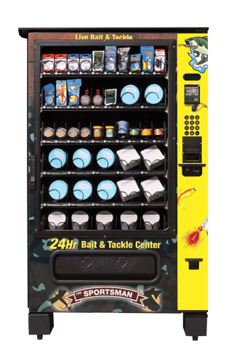
WELCOME
We thank you very much for purchasing your Sportsman 24 Hour Bait Shop
This quick start guide is a program that was put together to help you set up and get familiar with your new Sportsman 24 Hour Bait Shop. It in no way is this program to take the place of your service manual or the programming guide. Please take the time and read both the service manual and programming guide. Doing so will help you get the most from your new investment.

Slide 3
When your vendor arrives
Your new Sportsman was carefully crated at the factory to ensure that no damage occurs during transport. That being said, damage can still take place during transport. It is very important to carefully inspect the vendor before signing the shipping documents. If there is any damage make sure that the damage is noted on all copies of the shipping papers. Make sure the driver initials the papers as well. If there is serious damage do not sign the bills and call us right away, we may have you refuse the shipment.
Next you will need to remove the shipping boards from the bottom of the machine. You will see splits in the front and back of these boards. Take a crow bar and place the end of crow bar in the splits and the boards will split apart.

Slide 4
Your Sportsman is now ADA Compliant
While making these changes we decided to add some nice new features, these are listed below

Slide 5
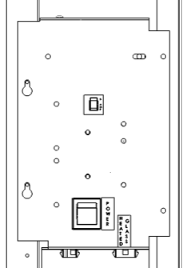
Opening your Sportsman
Your key will be taped in the coin return tray. Open door by turning key in lock and lifting lever after you turned the key. Please note: The lock provided with the machine is a shipping lock. This lock should be replaced with your own lock before putting on location and operating.
After opening the unit look inside the delivery bin remove all internal packing material and remove the power cord. Now go to the rear of the machine and remove the metal plate located at the lower left side of machine, plug the cord into the vendor and fasten plate back on the machine. Now plug the vendor in a standard 110 outlet. Make sure that is no other vending machine or ice machine on the circuit.
Main Power Switch
Door Glass Heater Connection
MAIN POWER SWITCH
Plug the power cord into a dedicated power outlet. Open the vendor door. Turn on the main power switch located on the Power Panel within the cabinet.
DOOR GLASS HEATER HARNESS CONNECTION
The Door Glass Heater Harness Connection is normally disconnected to conserve energy. In environments where the humidity is above 70% the Glass Heater Harness should be connected to prevent water condensation from forming on the glass surface. When the ambient conditions are below 70% humidity the glass should be disconnected. See above picture

Slide 6
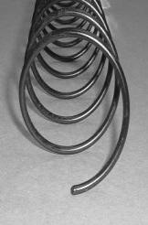
SPIRAL ADJUSTEMENT
The shape, size and thickness of a product affect how well it falls off the tray. Most products can be vended successfully when the spiral end is positioned at 6 o’clock. If vending problems occur with spiral ends at the standard 6 o’clock position, adjust the drop-off either by retiming the spiral or installing a Product Pusher.
SPIRAL TIMING
SNACK/CANDY/FOOD TRAY
Each spiral can be rotated in 20º (degree) increments for a different drop-off point. Most products can be vended successfully when the spiral end is positioned at
the position of 6 o’clock.
The general rule is:
The narrower the product, the higher the timing.
Thick Products - 4-6 o’clock
Most products – 6 o’clock
Thin Products - 6-8 o’clock
TO CHANGE SNACK/CANDY/FOOD SPIRAL TIMING:
1. Remove the motor cover.
2. Raise the motor slightly and pull forward on the spiral until it separates from the motor.
3. Rotate the spiral to the desired position and re-insert the hub (spiral coupling) into the
motor. The hub must be seated over the vertical rail or retaining rib on the tray
4. Replace the motor cover, making sure it is securely tightened.
5. Test-vend to make sure product vends properly.
ADJUST SPIRAL END POSITION FOR SUCCESFUL VEND.
MOST PRODUCTS VEND PROPERLY AT THE
6:00 (0'CLOCK) SETTING
SHOWN ABOVE

Slide 7
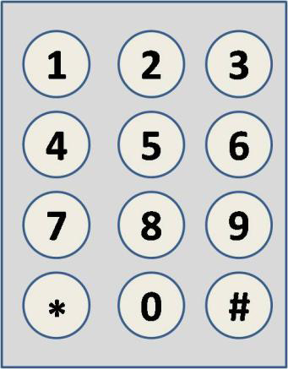
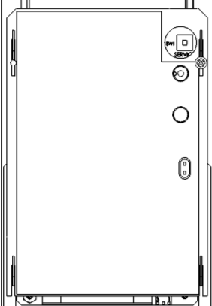
KEYPAD
Entries from the keypad will be displayed on the front vendor display.
Buttons 0-9 are used to move between the various modes, menus and sub-menus; while the button is used to enter a menu, confirm or save a setting.
DISPLAY
Check the display after pressing the Service Mode Button and/or Keypad Buttons to make sure that the program is responding correctly.
SERVICE MODE
Use the Service Mode to program and service the vendor. Use the keypad as an input device. Watch the display for information while in Service Mode.
SERVICE MODE BUTTON
To enter Service Mode, press the Service Mode Button located on the top or upper right corner of the controller cover To exit Service Mode, press the Service Mode Button.
NOTE: If no key is pressed for approximately one minute while in Service Mode, the controller will automatically return to Sales Mode.

Slide 8
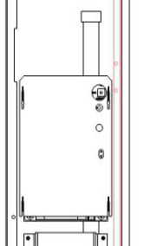
Loading Coin Mechanism
The Coin Mechanism must be loaded with some level of each coin in order for the vendor to operate properly. The coins need to be loaded into the coin mechanism by insertion into the front coin insert. First enter the SERVICE MODE then TUBE FILL MODE
Make sure to load the correct coins into their correct tubes. Each tube should be kept loaded with at least one roll of each coin to keep above the tube low level sensors. Once the tubes are loaded to these levels the Dollar Bill Validator will accept bills. If the coin tubes fall below this level the Dollar Bill Validator may stop accepting bills and the front display will indicate "EXACT CHANGE ONLY".
Alternatively, you can load the coins into the slots above the respective coin tubes. This is not the preferred method. By using TUBE FILL mode the control board can then accurately determine coin levels.
On some Coin Mechanisms there are buttons above each tube to dispense the coins (may vary depending on which coin mechanism that is used). The coins can also be dispensed within the Service Mode described later.
PRESS SERVICE MODE BUTTON AND ENTER TUBE FILL MODE (PRESS 1)

Slide 9
#1 TUBE FILL
1 TUBE FILL/ DISPENSE COINS Tube Fill counts coins as they are deposited and
Shows the dollar amount.
Tube Dispense
Pays out coins from the coin mech coin tubes.
This mode will also display the current quantity of coins in the coin mech tubes. TUBE FILL
STEP DISPLAY
Press Service Mode Button
Motor count 43
Press # 1 and begin depositing coins
At least 15 of each denomination
3. Press * 2 times to exit (Sales Mode)
TUBE DISPENSE
STEP DISPLAY
1. Press to dispense dollar coin $1.00/coins
2. Press to dispense quarters 0.25/coins
3. Press to dispense dimes 0.10/coins
4. Press to dispense nickels 0.05/coins
5. Press 2 times to exit (Sales Mode)

Slide 10
5 PRICING
Price Setting - This menu allows these methods for assigning prices:
ITEM — #1 by individual selections
ROW— # 2 by shelf or tray
ALL ITEMS # 3 — by entire vendor.
COUPONS — by Item, Row, or ALL
TOKENS — by Item, Row, or ALL
COMBO
The maximum price that can be set is $655.35.
PRICING BY ITEM
1. Press Service Mode Button - will display Motors ( 43)
2. Press 5 will display Pricing
3. Press 1 will display Item
4. Enter Item and price Item 010 $0.50
5. Press # to save. The program will automatically go to the next selection number. Item 010 $0.50
6. Press 3 times to exit. Will go back to (Sales Mode)

Slide 11
TEMPERATURE SETPOINT
We found that for bait vending it’s best to raise the temperature
set point up to 45 degrees.
Your Sportsman should be preset for bait at 45F from the factory. If not please follow the instructions below. If wish to change you vendor to a different temp, use the instructions below.
STEP DISPLAY
1. Press Service Mode Button Motors ( 43 )
2. Press 3 this will display “Options”
3. Press 8 to view/change machine temperature set point 36F keep pressing 8 until you reach 45F
4. Press to save set point 36F
5. Press 2 times to exit Sales Mode
Keep pressing #8 if you go too high it only goes up, it will go all the way up then it will go to 36F
WHEN CHANGING THE TEMP SET POINT PLEASE MAKE SURE THE HEALTH SAFTY FUNCTION IS TURNED OFF, BOTH UPPER AND LOWER.

Slide 12
TURNING OFF THE HEALTH SAFTY FUNCTION
To shut off Health Safety (HS)
Service Mode Button - will read motor count, says 43D
Press 4
Then 9
Press 1 -upper zone then 3 twice to turn off all items
Press 2 –lower zone then 3 twice to turn off all items
Press # to save after each zone
Press * to EXIT
Upper zone should be off from the factory.

Slide 13
Turn off POS message
The POS message will read “are you hungry enjoy a snack”, this needs to be shut off when selling fishing bait.
Turn OFF (or ON) the default scrolling display message.
STEP DISPLAY
1. Press Service Mode Button Motors ( 43 )
2. Press 3 Options
3. Press 7 POS Message ON
4. Press 7 to toggle ON or OFF.
POS Message OFF
5. Press # to save setting. POS Message OFF
6. Press *3 times to exit. (Sales Mode)
To enter your own scrolling message go to 7. Advanced Options (Password: 2314) 2. Enter POS Message

Slide 14
Accounting
This is where you can go to see what your machine is selling. You can check reset cash & vends and historical cash & vends. You can not turn back historical vends. After checking your reset vends make sure you reset back t0 0
Press 6. for Accounting
Press 3 for Accounting All menu
press 1. for Historical vends
Press 2.for Historical Cash
Press 3. for Resettable Count
Press 4.for Resettable Cash

Slide 15
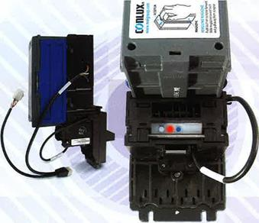
Setting your bill validator to accept $10 & $20 dollar bills.
When your Sportsman arrives it is set from the factory to accept only $1’s & $5 dollar bills. The following is the procedure for turning on the $10 and $20’s
After you have loaded your change. Make sure you are in the sales mode. Then make sure you have a steady red light on the back of the acceptor. Then lightly press the small blue button next the red light. When that starts flashing rapidly, go to the front of the machine and insert the $10.
The $10 will go in then come out. Check to make sure the light turns steady red again. We it does the reinsert the $10, it should take it. Follow the same procedure for the $20. Doing it again will turn the bill off.

Slide 16
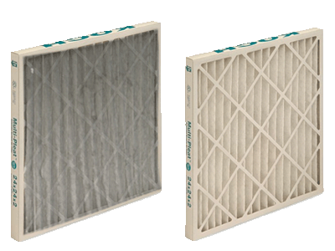
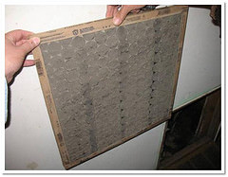
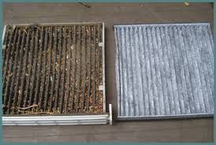
CHECK YOUR FILTER OFTEN! & REPLACE AS NEEDED!
A dirty filter will hamper the machines ability to cool properly. You are given a spare filter. Replacements can be purchased locally. It is very important that you keep your filter clean.

Slide 17
BEFORE CALLING FOR SERVICE
Please check the following:
Does your vending vendor have at least 6-inches of clear air space behind it?
If the power is turned on at the fuse box, is the vending vendor the only thing that doesn’t work?
Is the vending vendor plugged directly into the outlet?
WARNING: Extension cords can cause problems.
DO NOT USE EXTENSION CORDS.
Is the evaporator coil free of dust and dirt?
Is the condenser coil free of dust and dirt?
Is the compressor free of dust? A blanket of dust can prevent the compressor from cooling in between workout cycles.
Is the circuit breaker at the fuse box reset?
Is the evaporator fan working? To check if the fan is running take a small piece of paper in front of the evaporator coil and see if the evaporator fan will draw the paper..
Is the condenser fan running? Fold a sheet of 8 1/2” x 11” paper in half. Place the paper in front of the condenser coil inlet screen located on the bottom right side underneath the cabinet and see if it draws the paper to it..
Is the shelf in front of the evaporator coil clear? (No tools, product, or other air-restricting items).
Is the temperature setting set as specified? See CONTROL SYSTEM Programming Manual .
NOTE: Setting the temperature colder does not accelerate cooling of product but may cause the product to freeze.
You can reach Gary Harsel of Live Bait Vending.com at any time if you have a problem with your Sportsman he can be reached at 610-942-2185 evenings & weekends call his cell at 484-885-4602
Call Gary first, there’s a good chance he can solve your problem. If he can’t the tech support team at Wittern is available on weekdays.

Slide 18
PARTS ORDERING PROCEDURE
When ordering parts, include the following:
1. The model and serial numbers of the vending vendor for which the parts are needed.
2. Shipping address.
3. Address where the invoice should be sent.
4. The number of parts required.
5. Always refer to the pertinent parts and/or part manual for the correct part number and description of a specific part.
NOTE: When RIGHT or LEFT is used with the name of a part, it means the person is facing the vending vendor with the door closed.
6. Any special shipping instructions.
7. Carrier desired: air or air special, truck, parcel post or rail.
8. Signature and date.
9. Purchase order number, if used.
Phone # is: 888-836-3638
Mail your order to:
VendNet™
165 North 10th Street
Waukee, IA 50263 USA
All orders are carefully packed and inspected prior to shipment. Damage incurred during shipment should be reported at once and a claim filed with the terminating carrier.
If you do not have the right parts manual: contact VendNet™.
If you have any questions, check out our Website www.vendnetusa.com or call VendNet. Ask for the Parts Department. We will be happy to assist you. Email: vendnet@vendnetusa.com

Slide 19



We hope you found this program helpful. On behalf of Live Bait Vending.com and Vending.com we thank you for purchasing your Sportsman 24 Hour Bait Shop. The Sportsman is designed to give you years of reliable service. We will do our very best to help your business be a success.

